Slide 1


Expanding on Nomad Jobs

Slide 2






ExpandingonNomad Jobs
UPGRADE
UPGRADE
UPGRADE
SERVER
SERVER
SERVER
Nomad v1.4.1
Nomad v1.4.3
20003
Port
80
CLIENT
CLIENT
UPGRADE
CLIENT
UPGRADE
U(1P0.G0.R2.1A4D3)E

Slide 3
HowCan We ImproveOur Environment?
q q q q q q q
Spread our application across nodes for high availability Monitor our application logs Upgrading the version of our application Improve the way we access our application Scale our application for dynamic workloads Use variables to limit hardcoding values Integrate Nomad with Vault and Consul

Slide 4

Job Placement

Slide 5
Job Placement
•When deploying applications, understanding where they will run is essential to ensure
the maximum uptime and high availability for consumers
•By default, Nomad will use the "binpack" algorithm for allocations on available client
nodes
•Bin packing can save costs by maximizing the resources of Nomad clients •However, bin packing can introduce risk to your application because it may not be
deployed across multiple client nodes
•You can configure Nomad scheduling to use a "spread" algorithm for the entire cluster,
or you can customize it per job within the job specification
job job
à à
spread
Placement
à
group
spread

Slide 6






Bin Packing
NOMAD CLIENT
NOMAD CLIENT
NOMAD CLIENT
NOMAD CLIENT
NOMAD CLIENT
NOMAD CLIENT
Bin Packing (default)
Spread-Based Scheduling
•
Utilize all of a node's resources before deploying applications on a different node
Maximizes resource utilization and density
Minimize infrastructure cost
•
Evenly deploy applications by prioritizing based on nodes that are least utilized
Distribute risk and ensures faster response and
recovery in case of a node outage
Optimized for performance
• •
•
•

Slide 7
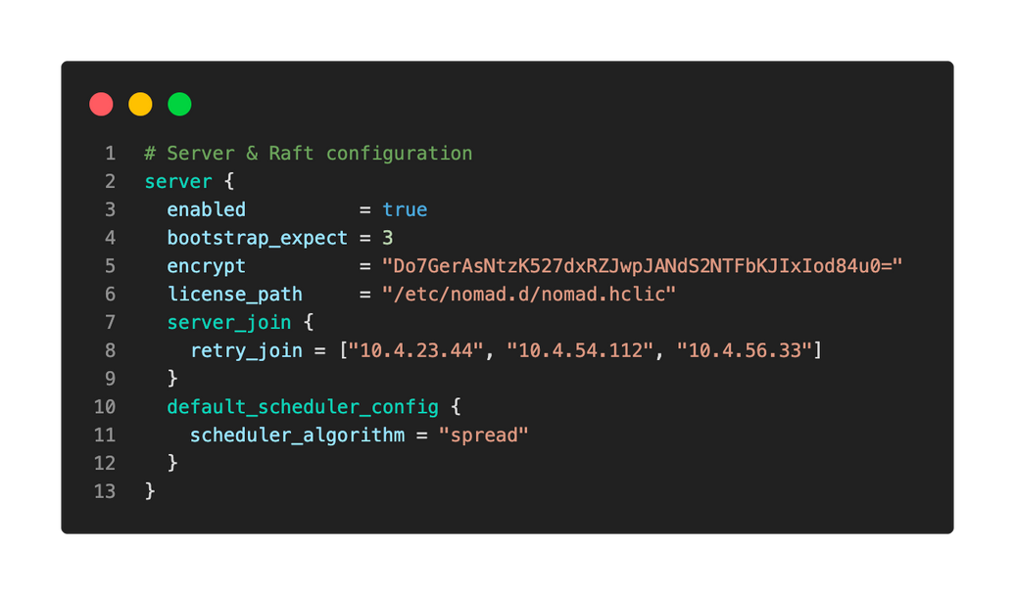
Customizable Scheduling
•
Choose “binpack” or “spread”
•
Customizable as one simple
string in Nomad’s configuration
Scheduling algorithm applies to
all applications deployed on the
cluster
•

Slide 8
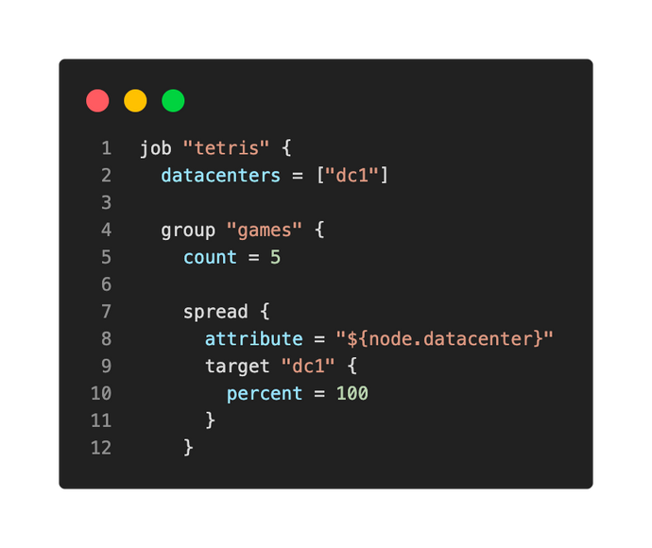
Job Placement
•
When using spread, the scheduler will attempt to place allocations equally among the available values of the given target
Spread can be used at the job level and/or
the group level
•
Spread can distribute tasks across
datacenters if you have federated
datacenters
•

Slide 9
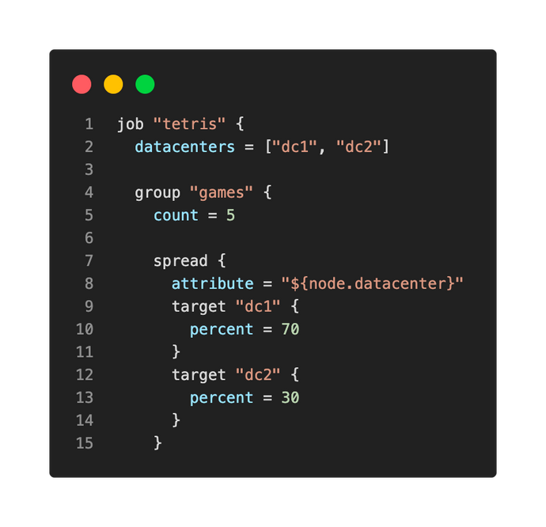
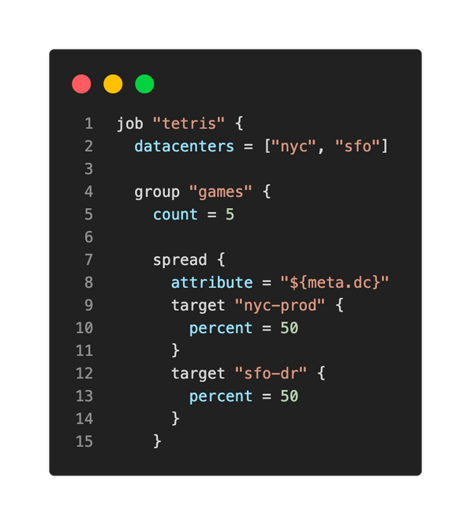
Job Scheduling
Schedule 70% of allocations to
Schedule 50% of allocations to the primary datacenter (NYC) and 50% to the DR
DC1 and 30% to DC2
datacenter (SFO) using user-defined metadata

Slide 10
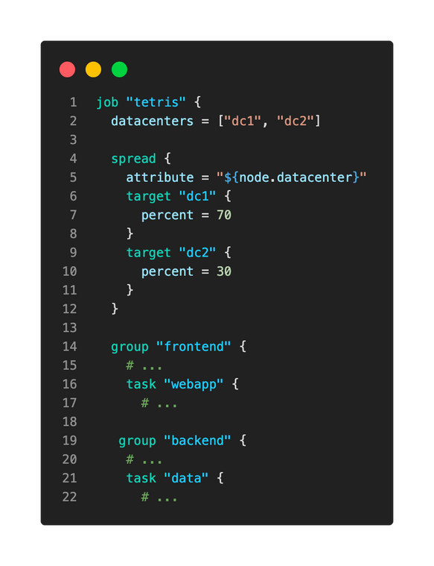
Job Scheduling
Spread is now under the job stanza
Job àSpread
This applies to all groups and tasks in the job
specification
Multiple groups in the job specification

Slide 11
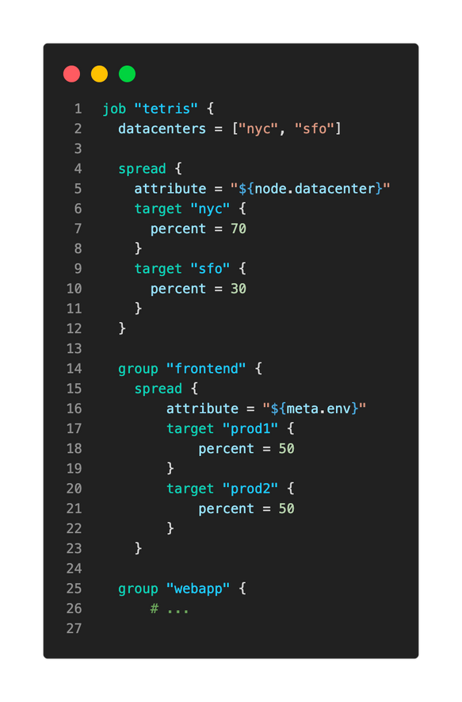
Job Scheduling
Multiple Spread Configurations
Spread all groups included in the job
specification across both the nycand sfo datacenters
x
Within each datacenter, spread allocations for the frontendgroup across Nomad clients that have user-defined metadata
for prod1and prod2
Note: If there is a conflict, the group level spread will take priority

Slide 12
DEMO
Job Placement

Slide 13
Job Constraints

Slide 14
Job Constraints
•
Constraints are requirements Nomad must evaluate about the client, such as the operating system, architecture, kernel version, and more before allocations are made….
Constraint requirements are specified at the job, group, or tasklevel
•
•
Examples:
•
•
•
•
Client must be Linux
Client must be running x64architecture
Client must be running on an underlying AWS instance that is m5.8xlarge
Client must have specific metadata
job job job
à à à
constraint group àconstraint group àtask àconstraint
Placement

Slide 15

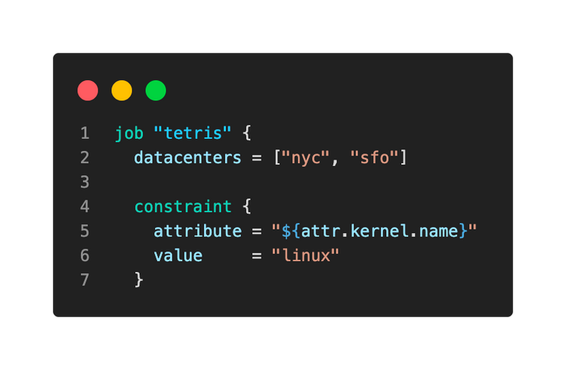






Job Constraints
NOMAD CLIENT
√
Job
NOMAD CLIENT
√
X
NOMAD CLIENT

Slide 16


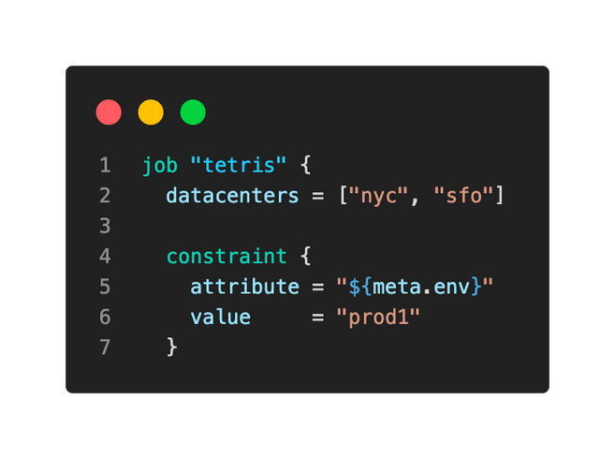







Job Constraints
Job
X
prod1
prod2
NOMAD CLIENT
NOMAD CLIENT
Client Agent Configuration
client {
NOMAD CLIENT
NOMAD CLIENT
enabled = true
meta {
env
rack
hardware
= "prod1"
= "rack-12"
= "cisco"
instructor = “raman"
}
}
NOMAD CLIENT
NOMAD CLIENT

Slide 17

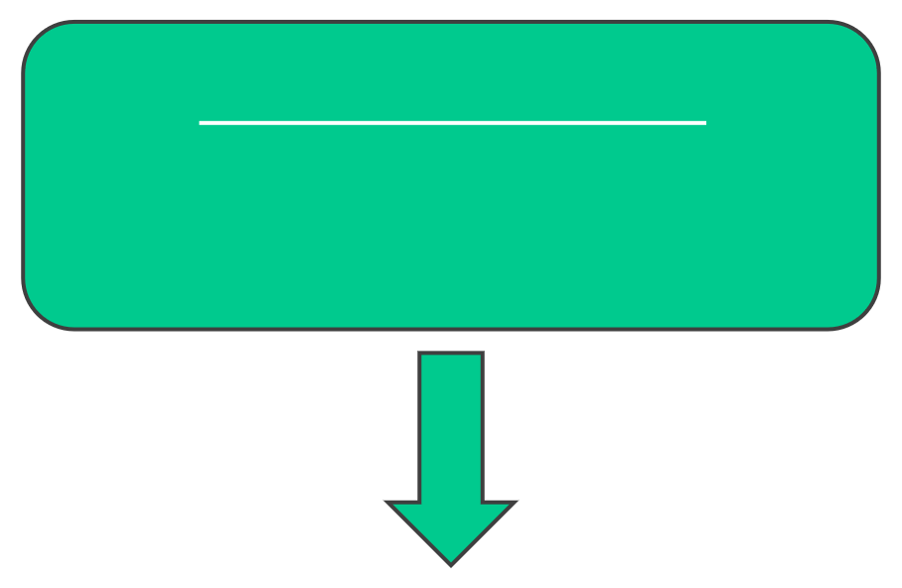
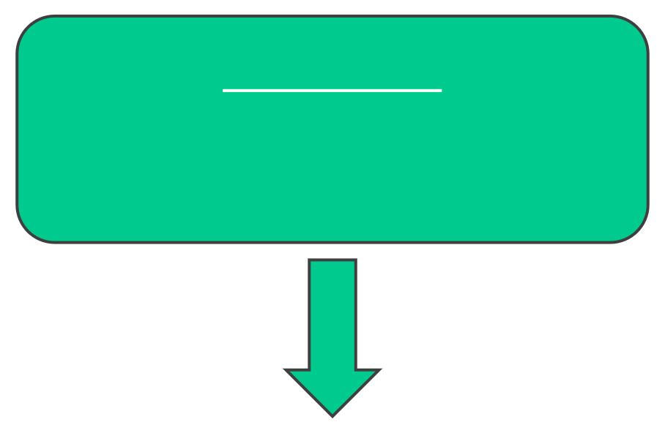

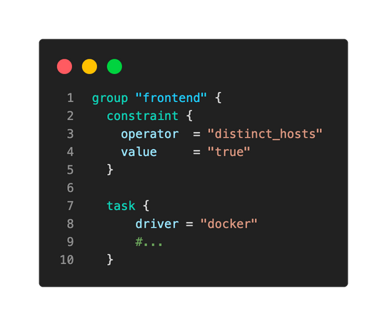
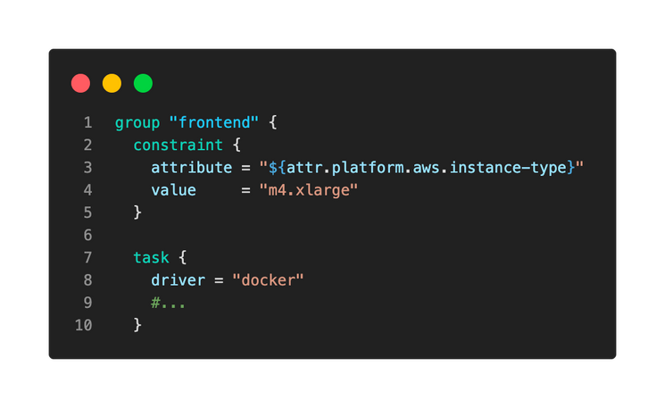
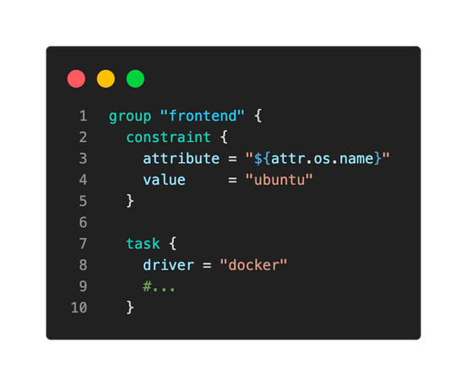
Job Constraints
Additional Examples
Distinct Hosts
Cloud Metadata
Client OS
Don't co-locate any tasks on
Prevent the task to only run on
Restrict the task to running on
the same client
nodes of size m4.xlarge
clients running Ubuntu
x

Slide 18
DEMO
Job Constraints

Slide 19
Networking

Slide 20
Networking
•
When deploying applications, networking is a critical component to ensure users can access the running applications
Networking is defined at the group level using the
•
network stanza
•
Options for networking include:
•
•
bridge: group will have an isolated network namespace with an interface bridged with the host host: (default) -each task will join the host network namespace –a shared network namespace is
not created
cni/<network>: task group will have an isolated network namespace with the CNI network none: each task will have an isolated network without any network interfaces
•
•
Placement
job
à
group
à
network

Slide 21


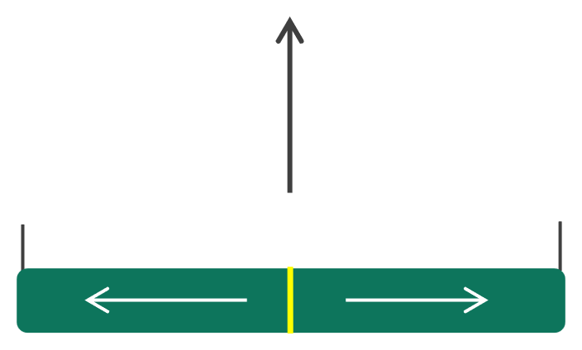


Networking Host Mode
• • •
Access via host IP address and dynamically allocated port Default port range is 20000 –32000 Relies on the task drivers to implement port mapping
CLIENT
(10.3.25.44)
tetris
port:80
20000
23002
32000
Dynamic Ports
10.3.25.44:23002

Slide 22
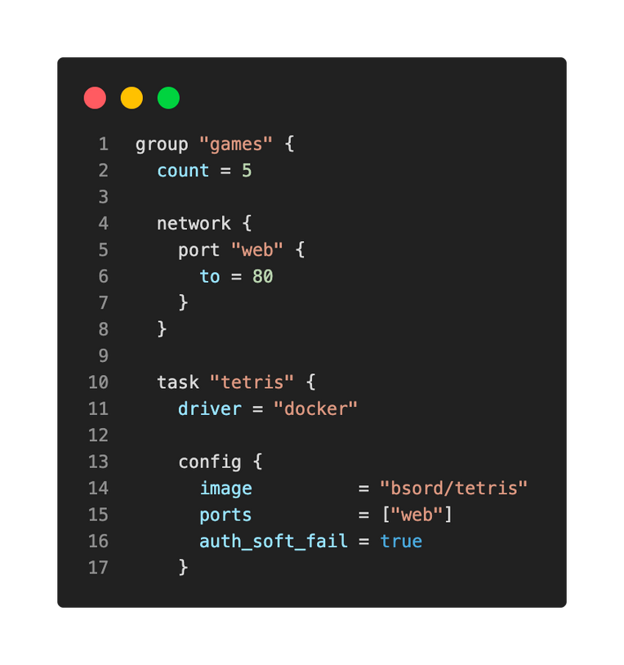
NetworkingMode -Host
This configuration is used when your application listens on a fixed port and you want to map to a dynamic port on the host
•
port–used to specify both dynamic and reserved ports. This example uses a reserved
port using the
uses a label called " Note that we do not need a
to parameter
• •
web"
mode = hosthere
because that is the default configuration
Reference the port label inside the task

Slide 23
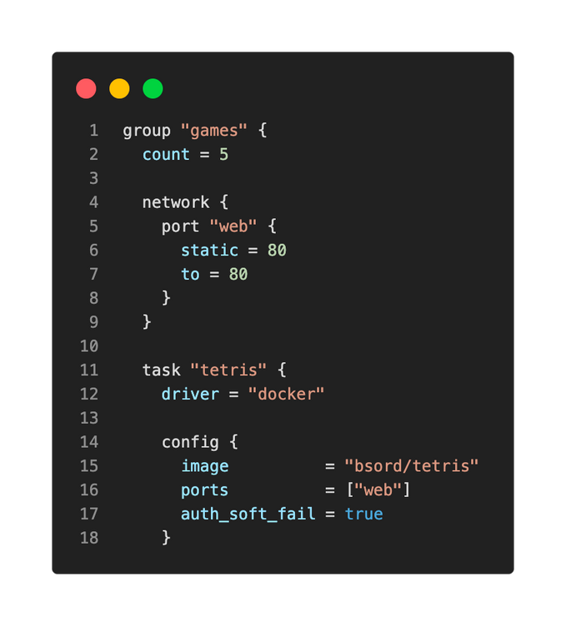
NetworkingMode -Host
This configuration is used when your application listens on a fixed port, and you need to map it to a staticport on the host
•
port
–used to specify both dynamic and reserved
staticport to
ports. This example specifies the
allocate on the host (not recommended)
Reference the port label inside the task

Slide 24
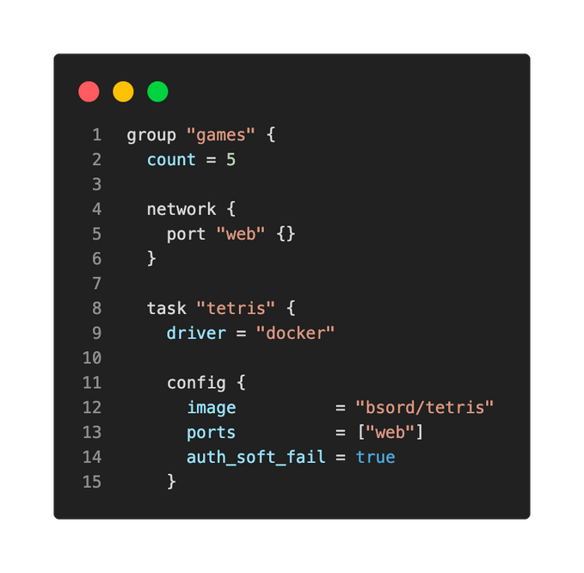
NetworkingMode -Host
•No configuration specifies a dynamic port allocation for
the task
•The application/service would need to read an
environment variable to know the port to bind to at startup NOMAD_PORT_webwould be passed to the task so it can
know the dynamic port
•
•Again, no need to specify
default configuration
mode = hostbecause it's the

Slide 25


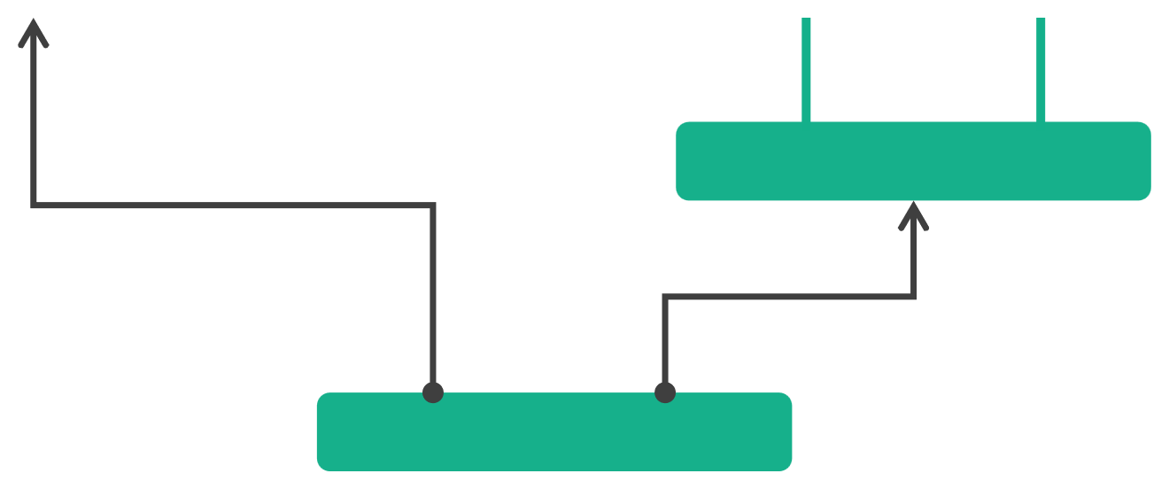

Networking Bridge Mode
• •
Access via host IP address and dynamically allocated port Default port range is 20000 -32000
CLIENT
(10.3.25.44)
web
tetris
scores
port:8080
port:443
port:80
172. 19. 0. 3
172. 19. 0. 4
Bridge
22464
24006
10.3.25.44:24006

Slide 26
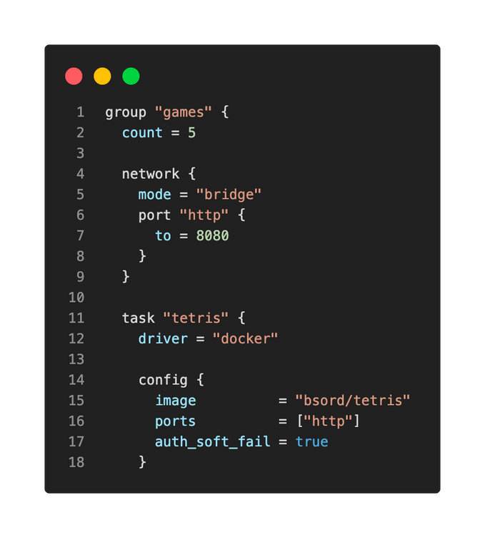
NetworkingMode -Bridge
This configuration is used when your application listens on a fixed port, and you want to connect to a bridged network on the host
•
mode = bridge
required since it's not the default
configuration
Reference the port label inside the task

Slide 27
DEMO
Networking

Slide 28
Working with Volumes

Slide 29
Working with Volumes
•
For workloads that require storage for stateful workloads, Nomad can provide access to host volumes or CSI volumes
Nomad is aware of host volumes during the scheduling process, allowing it to make
scheduling decisions based on the availability of host volumes on a specific client
•
However, Nomad is NOTaware of Docker volumes because they are managed outside of
Nomad. Therefore, the scheduler cannot make decisions based on availability
•
Of course, volumes are available to other resources beyond containers, such as
java apps
•
execand
Placement
job
à
group
à
volume

Slide 30
Working with Volumes
•
A
hostvolumeis essentially a path on the client that is made available to jobs. The
data is stored locally on the Nomad client
•
csi-volumeis exposed to jobs using a CSI plugin to consume externally created
storage volumes. Examples of these include AWS EBS volumes, GCP persistent disks,
Ceph, vSphere, and more
A
Placement
job
à
group
à
volume

Slide 31
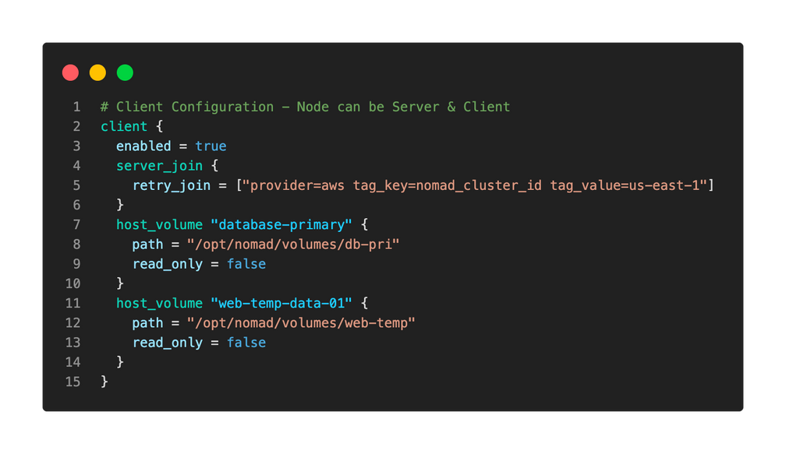


Host Volumes
Host volumes must be first configured using the
block in the
client
Nomad agent configuration file:
Name of Volume
Path on Nomad client

Slide 32
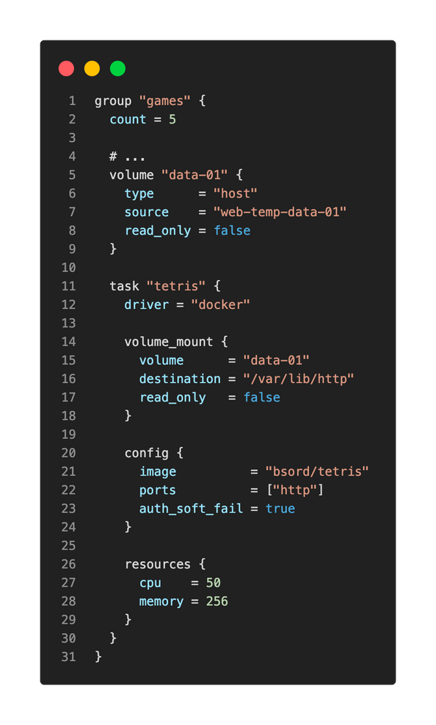


Host Volumes
Specify the Required Volume for the
games Group
•
Once the volume is ready to use, it is
referencedwithin the group using
the
volumeparameter
Specifies where a group volume
should be mounted
•The task will reference the volume required for the task to run using the
volume_mountparameter

Slide 33

CSI Volumes
•
CSI volumes are dynamically mounted by CSI plugins.
•
These plugins actually run as a system job and can mount volumes created by cloud providers
or storage platforms. No updates to the client agent configuration file needed*!
Again, Nomad is aware of CSI volumes, which allows Nomad to schedule your workloads
based on the availability of volumes on a client
•
CLIENT
CLIENT
CLIENT
X
web
web
Client doesn't have access to storage
Cloud Volume
* ok, maybe one small one but not per volume

Slide 34
CSI Volumes
•
Since the CSI plugins are written by the storage vendors, any CSI plugin that supports Kubernetes should work with Nomad
CSI volumes are supported by a large number of storage platforms and cloud
providers, including:
•
•AlicloudDisk/NAS/OSS
•AWS EBS
•AWS EFS
•AWS FSx
•
•
•
•
Dell EMC PowerMax/PowerScale/Unity/etc
Google Cloud Filestore/Storage
IBM
NFS
Azure Blob/Disk/File
• Portworx (Pure)
•
• CephFS
•
SMB
• Synology
•
Cisco Hyperflex
•
vSphere
https://kubernetes-csi.github.io/docs/drivers.html

Slide 35

Required Steps for CSI Volumes
1 2 3
4
5
Create the volume on your platform of choice
Enable Privileged Docker jobs
Run the plugin job for the specific driver needed
Register the volume with Nomad
Deploy the application that will use the volume

Slide 36
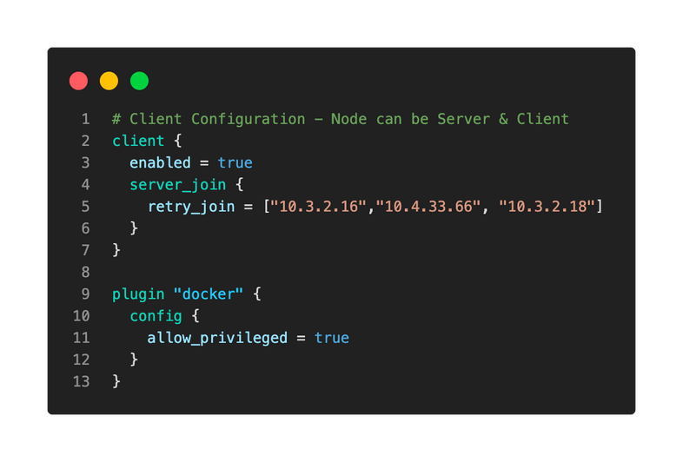
Enable Priviledged Docker Jobs
•
CSI plugins run as a privileged Docker job since they use bidirectional mount propagation to mount disks to the host
The default configuration does not allow
privileged Docker jobs, so you must update
your client configurationto permit them
•

Slide 37
Create the Plugin Job
•Each CSI plugin supports one or more types of jobs –Controller,
Nodes, orMonolith
•Most CSI plugins require that you run both a controller and a
nodes job
•Node plugins are usually run as
These jobs use the
system jobs
•
csi_pluginstanza in the job spec file

Slide 38
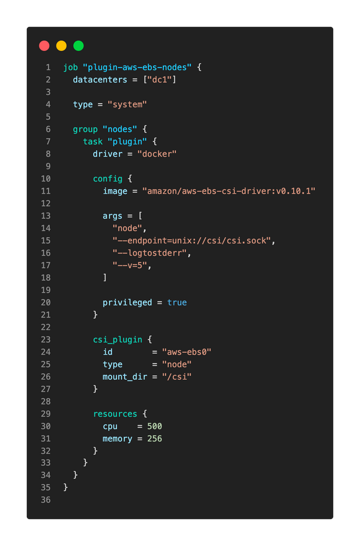




Create the Plugin Job
this is a
system
job
location of the driver image
Run as a privileged job
Specifies this task provides a CSI
plugin to the cluster

Slide 39
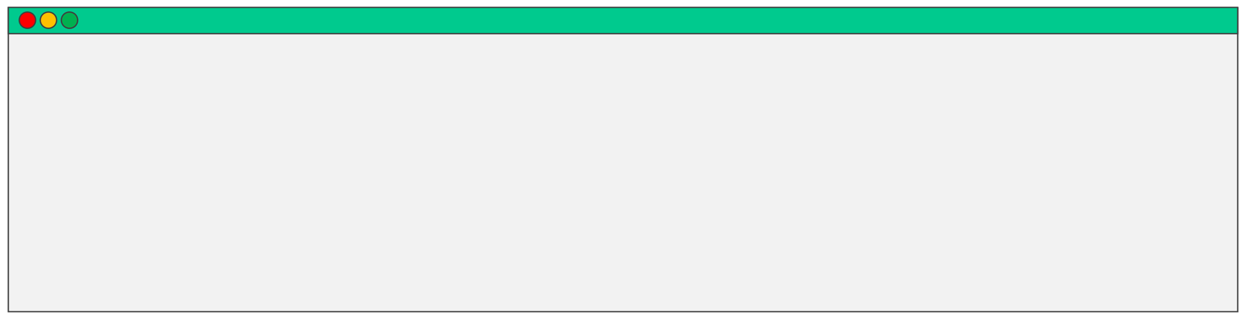
Deploy the Plugin Jobs to Nomad
Once you have the plugin job specifications ready, you can create the jobs in Nomad:
TERMINAL
$ nomad job run csi_plugin.hcl
==> 2023-01-26T17:20:29-05:00: Monitoring evaluation "b66aaf83"
2023-01-26T17:20:29-05:00: Evaluation triggered by job "plugin-aws-ebs-nodes" 2023-01-26T17:20:30-05:00: Allocation "f329afdd" created: node "7ff357a0", group "nodes" 2023-01-26T17:20:30-05:00: Evaluation status changed: "pending" -> "complete"
==> 2023-01-26T17:20:30-05:00: Evaluation "b66aaf83" finished with status "complete"

Slide 40
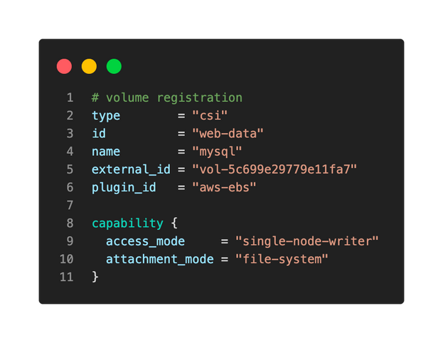
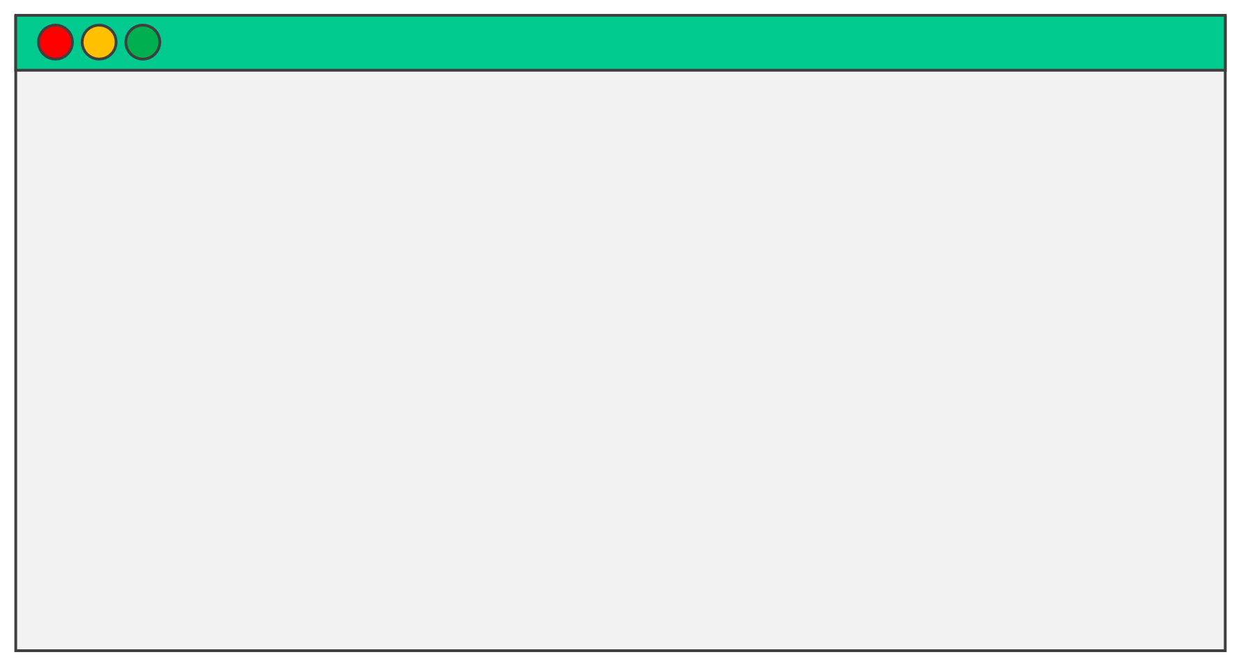

Register theVolume
Each volume needs to be registered with Nomad to ensure the CSI plugins know about each volume
TERMINAL
$ nomad volume register ebs_volume.hcl
ID = web-data Name = web-data External ID = vol-5c699e29779e11fa7 Plugin ID = aws-ebs Provider = ebs.csi.aws.com Version = v0.10.1
…

Slide 41
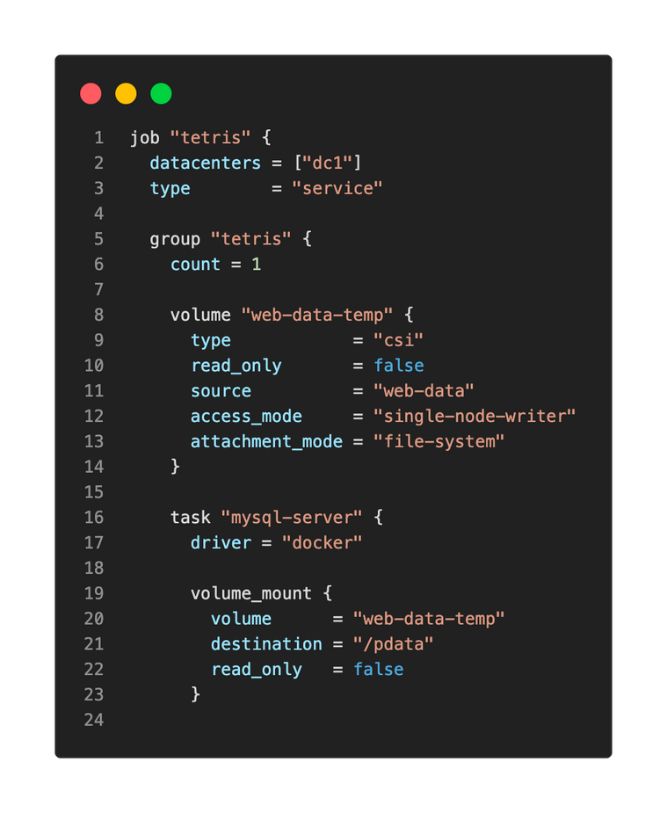
CreatetheJobtoUse theVolume
And….finally. Create the job for the task(s) that will consume the new CSI volume

Slide 42
DEMO
Nomad Volumes

